Slide 1

Based Automata Scheduler for Dynamic Resource Allocation in Cloud Computing
Represnted by
I. Harsha vardhan Reddy-192211566

Slide 2

Introduction to Cloud Computing and Resource Allocation Challenges
1
Dynamic Workloads
2
Scalability
The scheduler must be able to scale up or down resources quickly to meet changing demands.
Cloud computing environments experience highly variable and unpredictable workloads that require flexible resource allocation.
3
Efficiency
Optimizing resource utilization is crucial to reduce operational costs and environmental impact.

Slide 3
Concept of Cellular Automata and Its Applications
Cellular Automata
Applications
Adaptability
Cellular automata have been successfully applied to model complex systems, including traffic flow, urban planning, and biological processes.
The decentralized and dynamic nature of cellular automata makes them well-suited for resource allocation in cloud computing environments.
Cellular automata are discrete computational models consisting of a grid of cells that evolve over time based on predefined local rules.

Slide 4

Principles of Based Automata Scheduler
1
Cell States
The scheduler represents cloud resources as a grid of cells, each with a dynamic state reflecting its utilization and availability.
2
Local Rules
The scheduler applies predefined local rules to determine how each cell's state should evolve based on its neighbors' states.
3
Dynamic Allocation
The scheduler dynamically allocates and deallocates resources based on the evolving state of the cellular automata grid.

Slide 5
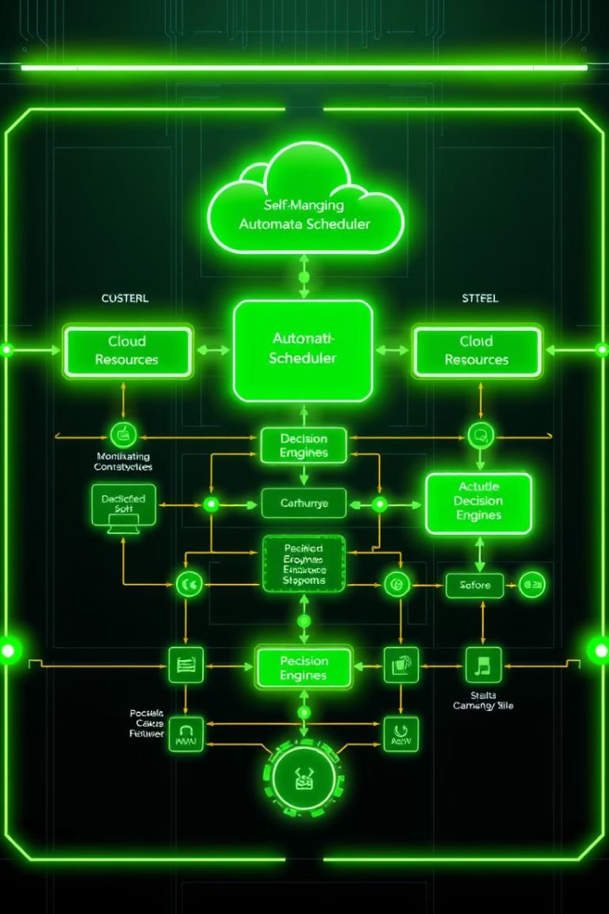
Architecture of Based Automata Scheduler
Resource Monitoring
Decision Engine
The decision engine applies the cellular automata rules to determine the optimal resource allocation based on the monitored data.
The scheduler continuously monitors the state of cloud resources, including CPU, memory, and network utilization.
Actuation
The scheduler then takes action to scale resources up or down based on the decisions made by the decision engine.

Slide 6




Algorithm for Dynamic Resource Allocation
Resource Monitoring
The algorithm continuously gathers and analyzes resource utilization data from the cloud environment.
Cellular Automata Rules
The algorithm applies the predefined cellular automata rules to determine the optimal resource allocation based on the monitored data.
Resource Scaling
The algorithm then scales resources up or down accordingly to meet the changing demands of the cloud workloads.

Slide 7
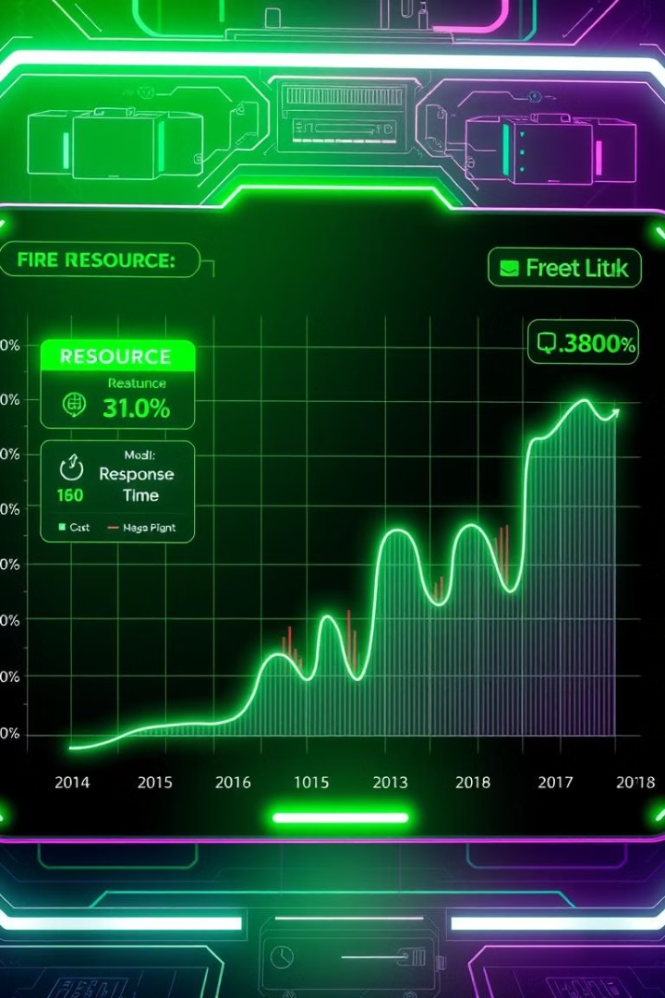



Experimental Setup and Performance Evaluation
Resource Utilization
The scheduler achieved high resource utilization by dynamically adapting to workload changes.
Response Time
The scheduler maintained low latency and high throughput, ensuring timely processing of cloud applications.
Cost Optimization
The scheduler reduced operational costs by efficiently utilizing cloud resources and minimizing overprovisioning.

Slide 8

Conclusion and Future Directions
1
Adaptable Scheduling
2
Ongoing Research
The Based Automata Scheduler demonstrates the potential of cellular automata for dynamic resource allocation in cloud computing.
Future work will focus on enhancing the scheduler's capabilities, exploring multi-objective optimization, and integrating with emerging cloud technologies.
3
Towards Efficient Clouds
The presented solution contributes to the development of more efficient, scalable, and sustainable cloud computing infrastructure.

Slide 9

Thank you
Thank you for your attention. We welcome any questions or feedback you may have.

